Slide 1
Operating System
Guangyao Zhou
guangyao_zhou@swjtu.edu.cn

Slide 2
I/O management and Disk scheduling
Categories of I/O Devices
Organization of the I/O Function
Design Objectives
Buffering
Disk Scheduling
Disk Cache
RAID

Slide 3
1. Categories of I/O Devices
External devices that engage in I/O with computer systems can be grouped into three categories:
  Human readable
    suitable for communicating with the computer user
    printers, terminals, video display, keyboard, mouse
  Machine readable
    suitable for communicating with electronic equipment
    disk drives, USB keys, sensors, controllers
  Communication
    suitable for communicating with remote devices
    modems, digital line drivers

Slide 4
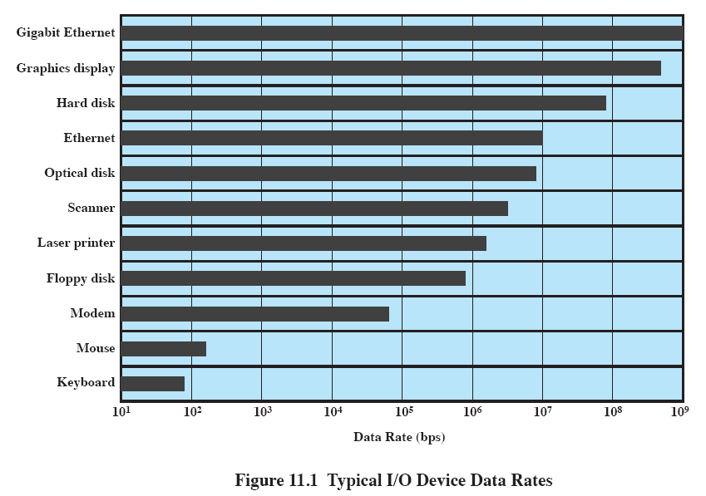
Differences in I/O Devices

Slide 5
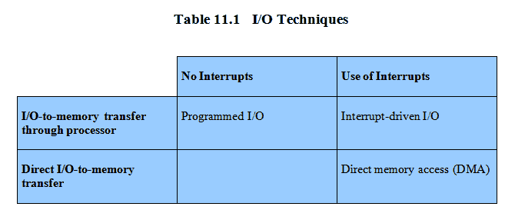
2. Organization of the I/O Function
CPU check the status of I/O continuously
Programmed I/O
  the processor issues an I/O command on behalf of a process to an I/O module;
  that process then busy waits for the operation to be completed before proceeding
Interrupt-driven I/O
  the processor issues an I/O command on behalf of a process
  non-blocking VS blocking
Direct Memory Access (DMA)
  a DMA module controls the exchange of data between main memory and an I/O module
After the CPU starts the I/O operation, it can proceed to execute other tasks until the I/O sends an interrupt signal
DMA replace CPU to control the data transfer

Slide 6
Evolution of the I/O Function
Processor directly controls a peripheral device (外围设备)
A controller or I/O module is added
Same configuration as step 2, but now interrupts are employed
The I/O module is given direct control of memory via DMA（直接存储访问器）
The I/O module is enhanced to become a separate processor, with a specialized instruction set tailored for I/O I/O channel （I/O通道）
The I/O module has a local memory of its own and is, in fact, a computer in its own right I/O processor

Slide 7
3. Design Objectives
Efficiency
  Major effort in I/O design
  Important because I/O operations often form a bottleneck
  Most I/O devices are extremely slow compared with main memory and the processor
  The area that has received the most attention is disk I/O
Generality（通用性）
  Desirable to handle all devices in a uniform manner
    the way processes view I/O devices
    the way the operating system manages I/O devices and operations
  Diversity of devices makes it difficult to achieve true generality
  Use a hierarchical, modular approach to the design of the I/O function
  →uniform function: read, write, open, close, lock, unlock

Slide 8
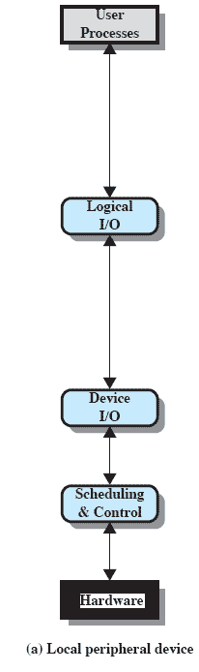
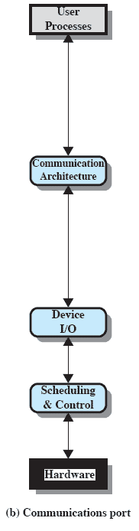
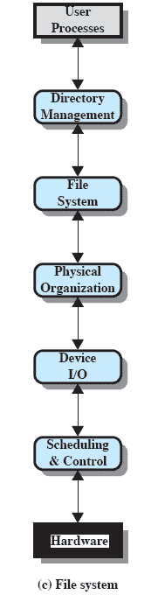
A Model of I/O Organization

Slide 9
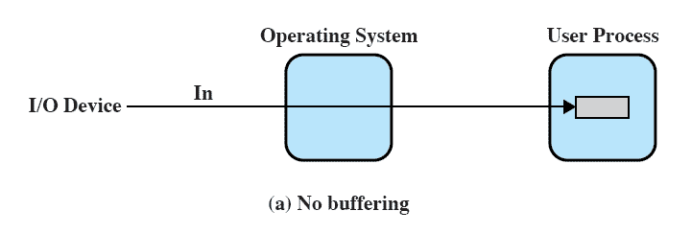
4. Buffering （缓冲）
No Buffer
  Without a buffer, the OS directly accesses the device when it needs
  Disadvantage: block/swap<--busy waiting (check the status of device continuously)

Slide 10
Buffering
Perform input transfers in advance of requests being made and perform output transfers some time after the request is made
Block-oriented device（面向块的设备）
  stores information in blocks that are usually of fixed size
  transfers are made one block at a time
  possible to reference data by its block number
  disks and USB keys are examples
Stream-oriented device（面向流的设备）
  transfers data in and out as a stream of bytes
  no block structure
  terminals, printers, communications ports, and most other devices that are not secondary storage are examples

Slide 11

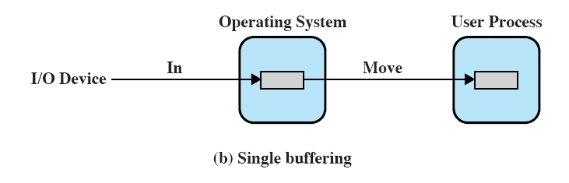
Single Buffer
Operating system assigns a buffer in main memory for an I/O request
Producer/customer

Slide 12

Block-Oriented Single Buffer
Input transfers are made to the system buffer
Reading ahead/anticipated input （预读）
  is done in the expectation that the block will eventually be needed
  when the transfer is complete, the process moves the block into user space and immediately requests another block
Generally provides a speedup compared to the lack of system buffering
Disadvantages:
  complicates the logic in the operating system
  swapping logic is also affected

Slide 13
Stream-Oriented Single Buffer
Line-at-a-time operation
  appropriate for scroll-mode （滚动模式） terminals (dumb terminals)
  user input is one line at a time with a carriage return （回车） signaling the end of a line
  output to the terminal is similarly one line at a time
Byte-at-a-time operation
  used on forms-mode （表格模式） terminals
  when each keystroke is significant
  other peripherals such as sensors and controllers

Slide 14
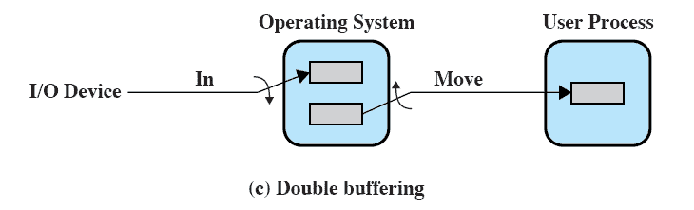
Double Buffer
Use two system buffers instead of one
A process can transfer data to or from one buffer while the operating system empties or fills the other buffer
Also known as buffer swapping （缓冲交换）

Slide 15
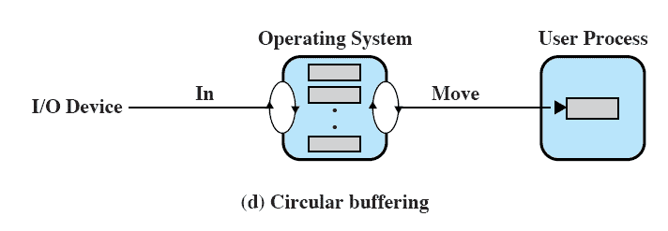
Circular Buffer
Two or more buffers are used
Each individual buffer is one unit in a circular buffer
Used when I/O operation must keep up with process

Slide 16
The Utility of Buffering
Technique that smoothes out peaks in I/O demand
  all buffers become full, so that their advantage is lost
When there is a variety of I/O and process activities to service, buffering can increase the efficiency of the OS and the performance of individual processes

Slide 17
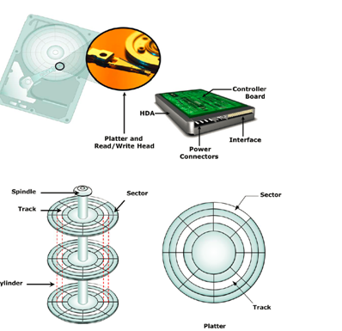
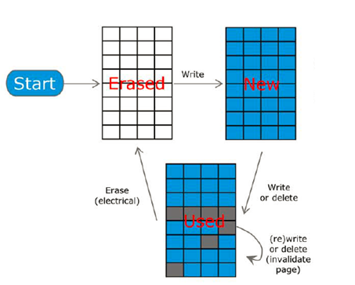
5. Disk Scheduling
HDD (Hard Disk Drive) vs SSD (Solid State Drive)

Slide 18
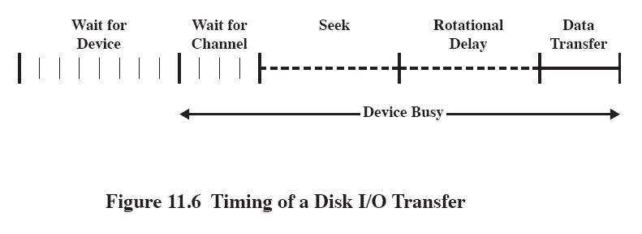
Disk Performance Parameters
The actual details of disk I/O operation depend on the:
  computer system
  operating system
  nature of the I/O channel and disk controller hardware

Slide 19
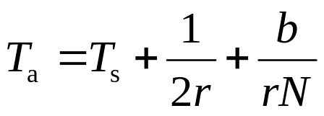
Positioning the Read/Write Heads
When the disk drive is operating, the disk is rotating at constant speed
To read or write the head must be positioned at the desired track and at the beginning of the desired sector on that track
Track selection involves moving the head in a movable-head system
  The time it takes to position the head at the track is known as seek time
  The time it takes for the beginning of the sector to reach the head is known as rotational delay
The sum of the seek time, the rotational delay and transfer time equals the access time (存取时间)
Seek time
Rotation delay
Transfer time

Slide 20
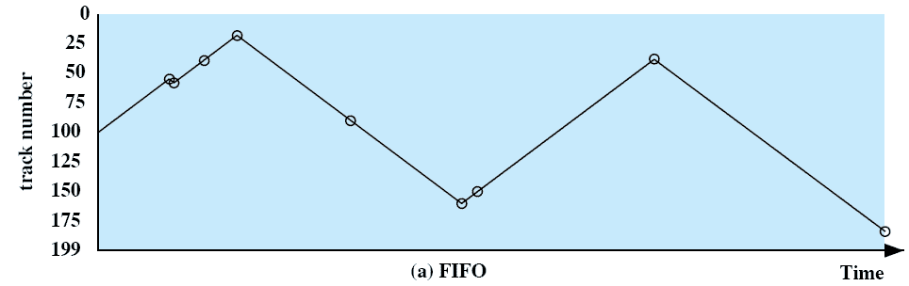
First-In, First-Out (FIFO)
Processes in sequential order
Fair to all processes
Approximates random scheduling in performance if there are many processes competing for the disk
Case: 55, 58, 39, 18, 90, 160, 150, 38, 184

Slide 21
Priority (PRI)
Control of the scheduling is outside the control of disk management software
Goal is not to optimize disk utilization but to meet other objectives
Short batch jobs and interactive jobs are given higher priority
Provides good interactive response time
Longer jobs may have to wait an excessively long time

Slide 22
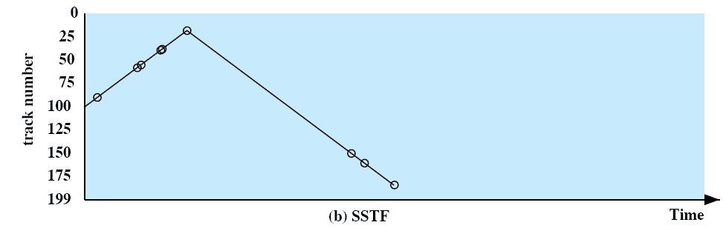
Shortest Service Time First (SSTF)
Select the disk I/O request that requires the least movement of the disk arm from its current position
Always choose the minimum seek time
Starvation
Case: 55, 58, 39, 18, 90, 160, 150, 38, 184

Slide 23
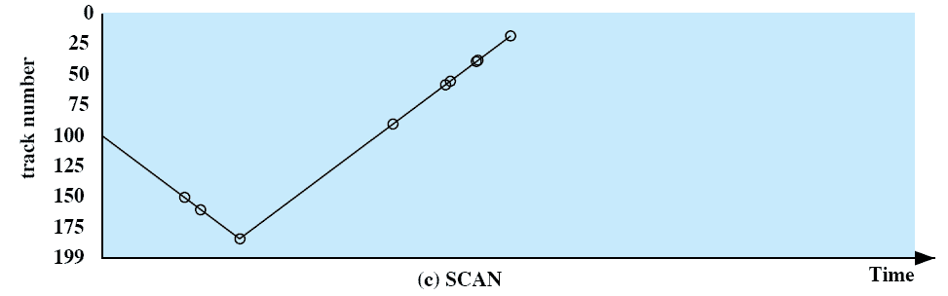
SCAN
Also known as the elevator algorithm
Arm moves in one direction only
  satisfies all outstanding requests until it reaches the last track in that direction then the direction is reversed
Favors jobs whose requests are for tracks nearest to both innermost and outermost tracks

Slide 24
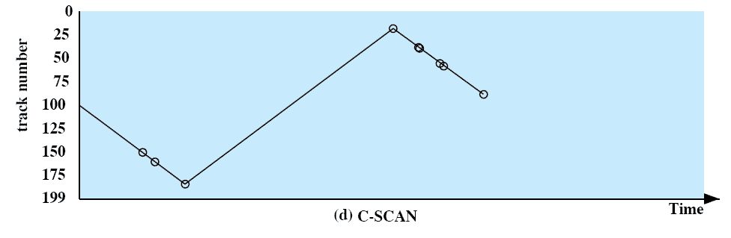
C-SCAN (Circular SCAN)
Restricts scanning to one direction only
When the last track has been visited in one direction, the arm is returned to the opposite end of the disk and the scan begins again

Slide 25
N-Step-SCAN
Segments the disk request queue into subqueues of length N
Subqueues are processed one at a time, using SCAN
While a queue is being processed new requests must be added to some other queue
If fewer than N requests are available at the end of a scan, all of them are processed with the next scan
SCAN v.s. FIFO

Slide 26
FSCAN
Uses two subqueues
When a scan begins, all of the requests are in one of the queues, with the other empty
During scan, all new requests are put into the other queue
Service of new requests is deferred until all of the old requests have been processed

Slide 27
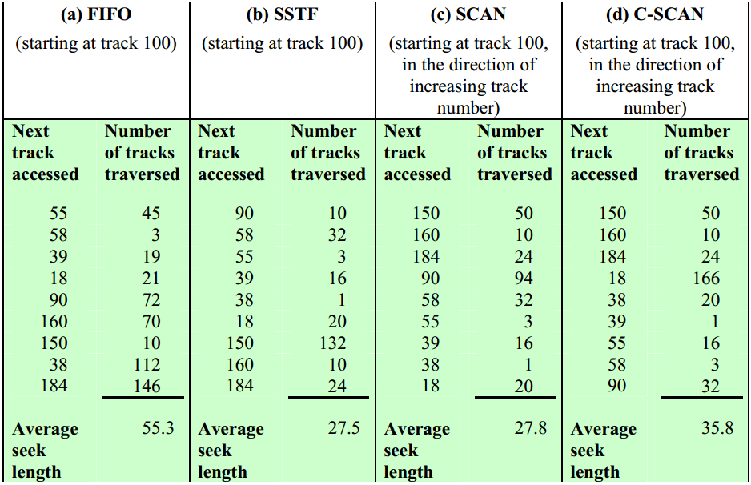
Table 11.2 Comparison of Disk Scheduling Algorithms

Slide 28
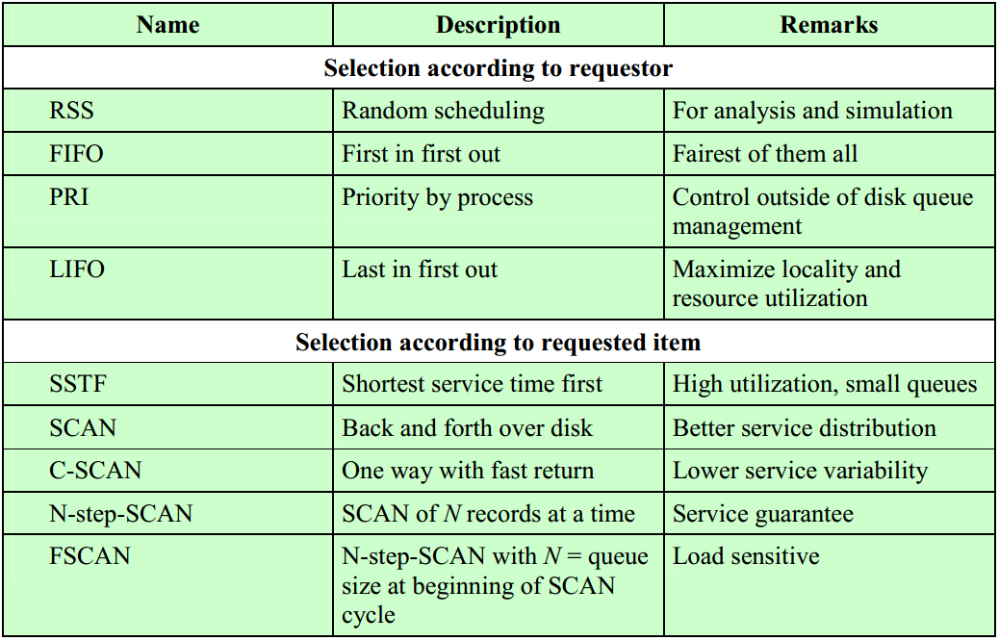
Table 11.3 Disk Scheduling Algorithms

Slide 29
6. Disk Cache
Cache memory is used to apply to a memory that is smaller and faster than main memory and that is interposed between main memory and the processor
Reduces average memory access time by exploiting the principle of locality
Disk cache is a buffer in main memory for disk sectors
Contains a copy of some of the sectors on the disk
when an I/O request is made for a particular sector, a check is made to determine if the sector is in the disk cache
  if YES
    the request is satisfied via the cache
  if NO
    the requested sector is read into the disk cache from the disk

Slide 30
It needs replacement Algorithms
When a new sector is read into the disk cache, an existing block must be replaced

Slide 31
Least Recently Used (LRU) 最近最少使用
Most commonly used algorithm that deals with the design issue of replacement strategy
  The block that has been in the cache the longest with no reference to it is replaced
A stack of pointers reference the cache
  most recently referenced block is on the top of the stack
  when a block is referenced or brought into the cache, it is placed on the top of the stack

Slide 32
Least Frequently Used (LFU) 最不常使用
The block that has experienced the fewest references is replaced
A counter is associated with each block
Counter is incremented each time block is accessed
When replacement is required, the block with the smallest count is selected
? Some blocks that have been visited multiple times in the short term but are not frequently accessed as a whole may have a high count ?

Slide 33
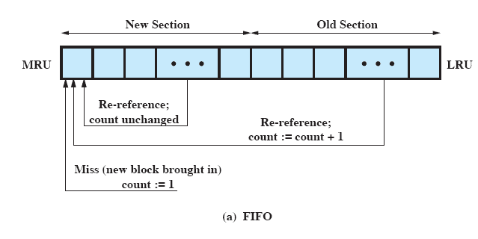
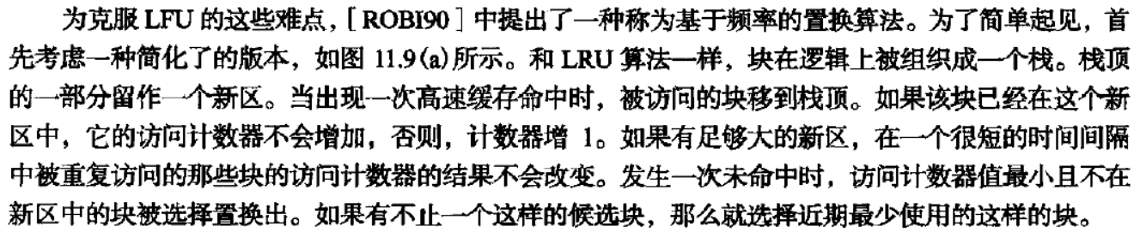
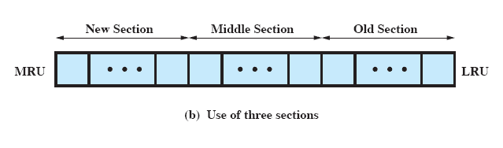
Frequency-Based Replacement

Slide 34
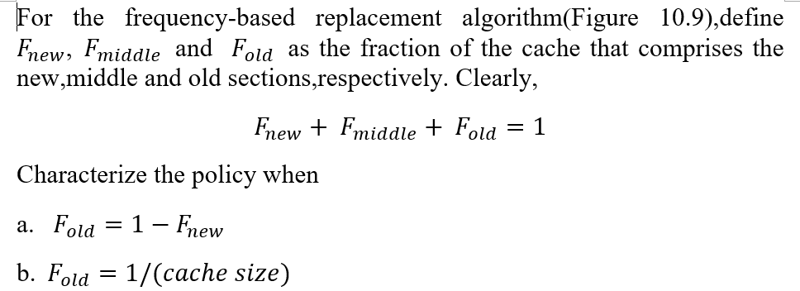
Quiz
Notes:
The middle section in Figure 11.11b is empty. Thus, this reduces to the strategy of Figure 11.11a.
The old section consists of one block, and we have the LRU replacement policy.

Slide 35
7. RAID
Redundant Array of Independent Disks (独立磁盘冗余阵列)
Consists of seven levels, zero through six
Design architectures share three characteristics:
  RAID is a set of physical disk drives viewed by the operating system as a single logical drive
  data are distributed across the physical drives of an array in a scheme known as striping(条带)
  redundant disk capacity is used to store parity information （校验）, which guarantees data recoverability in case of a disk failure

Slide 36
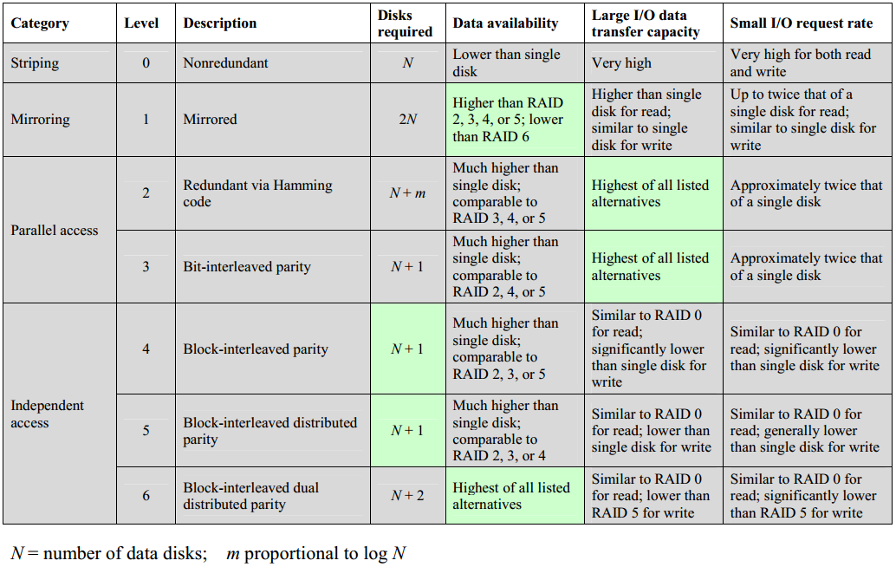
Table 11.4 RAID Levels

Slide 37
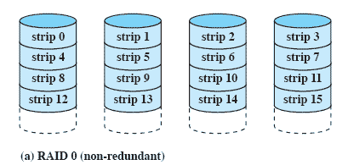
RAID Level 0
Not a true RAID because it does not include redundancy to improve performance or provide data protection
User and system data are distributed across all of the disks in the array
Logical disk is divided into strips

Slide 38
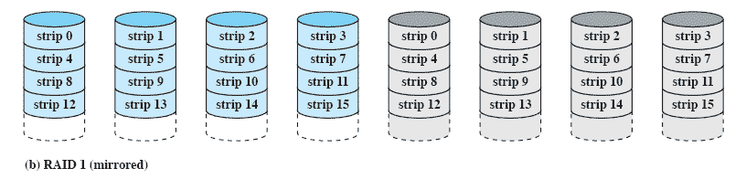
RAID Level 1
Redundancy is achieved by the simple expedient of duplicating all the data
There is no “write penalty”
When a drive fails the data may still be accessed from the second drive
Principal disadvantage is the cost

Slide 39
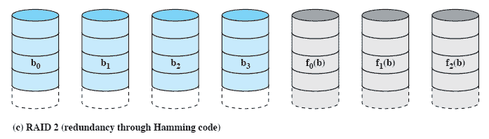
RAID Level 2
Makes use of a parallel access technique
Data striping is used (small strip with one bit or word usually)
Typically a Hamming code is used (Given a certain number of bits, other bits can be obtained through logical operation)
Effective choice in an environment in which many disk errors occur

Slide 40
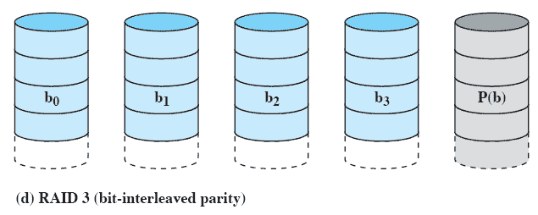
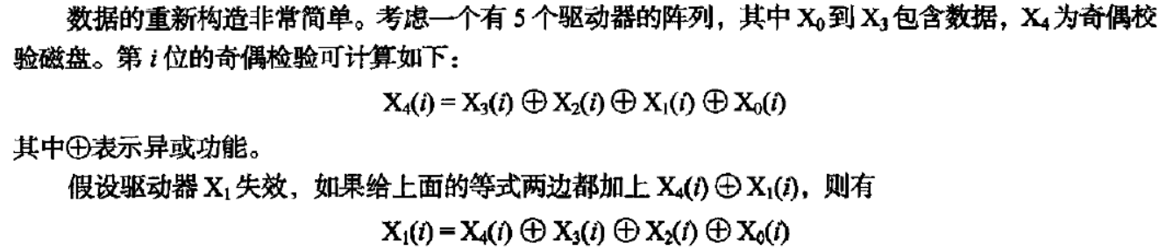
RAID Level 3
Requires only a single redundant disk, no matter how large the disk array
Employs parallel access, with data distributed in small strips
Can achieve very high data transfer rates

Slide 41
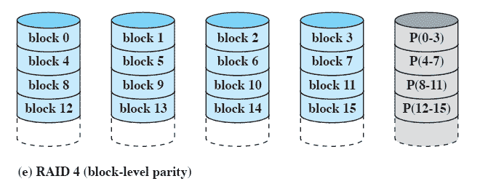
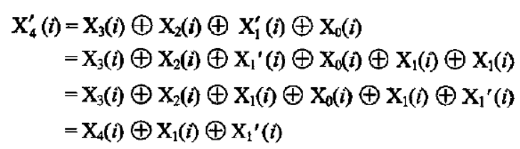
RAID Level 4
Makes use of an independent access technique (large strip with data block)
A bit-by-bit parity strip is calculated across corresponding strips on each data disk, and the parity bits are stored in the corresponding strip on the parity disk
Involves a write penalty when an I/O write request of small size is performed

Slide 42
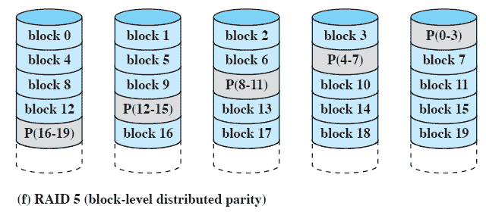
RAID Level 5
Similar to RAID-4 but distributes the parity bits across all disks
Typical allocation is a round-robin scheme
Has the characteristic that the loss of any one disk does not result in data loss
Avoiding potential I/O bottleneck issues with a parity check disk in RAID 4

Slide 43
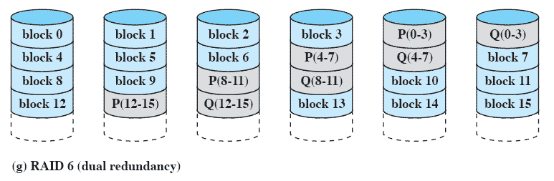
RAID Level 6
Two different parity calculations are carried out and stored in separate blocks on different disks
Provides extremely high data availability
Incurs a substantial write penalty because each write affects two parity blocks
N+2, Data loss only occurs when three or more disks are damaged simultaneously

Slide 44
Table 11.4 RAID Levels

Slide 45
Summary
I/O architecture is the computer system’s interface to the outside world
  I/O functions are generally broken up into a number of layers
  A key aspect of I/O is the use of buffers that are controlled by I/O utilities rather than by application processes
Buffering smoothes out the differences between the speeds
  The use of buffers also decouples the actual I/O transfer from the address space of the application process
Disk I/O has the greatest impact on overall system performance
  Two of the most widely used approaches are disk scheduling and the disk cache
A disk cache is a buffer, usually kept in main memory, that functions as a cache of disk block between disk memory and the rest of main memory

Slide 46
Quiz
Consider a 4-drive, 200GB-per-drive RAID array. What is the available data storage capacity for each of the RAID levels, 0, 1, 3, 4, 5, and 6?

Slide 47

单选题
1分
此题未设置答案，请点击右侧设置按钮
1.在操作系统中,用户在使用I/O设备时,通常采用( )。
A
物理设备名
B
逻辑设备名
C
虚拟设备名
D
设备牌号
提交
Notes:
B

Slide 48
单选题
1分
此题未设置答案，请点击右侧设置按钮
2.操作系统采用缓冲技术,能够减少对CPU的( )次数,从而提高资源的利用率。
A
中断
B
访问
C
控制
D
依赖
提交
Notes:
A

Slide 49
单选题
1分
此题未设置答案，请点击右侧设置按钮
3.CPU输出数据的速度远远高于打印机的打印速度,为了解决这一矛盾,可采用( )。
A
并行技术
B
通道技术
C
缓冲技术
D
虚存技术
提交
Notes:
C

Slide 50
单选题
1分
此题未设置答案，请点击右侧设置按钮
4.缓冲技术用于( )。
A
提高主机和设备交换信息的速度
B
提供主、辅存接口
C
提高设备利用率
D
扩充相对地址空间
提交
Notes:
A

Slide 51
单选题
1分
此题未设置答案，请点击右侧设置按钮
5.通道是一种( )。
A
I/O端口
B
数据通道
C
I/O专用处理机
D
软件工具
提交
Notes:
C

Slide 52
Quiz
Notes:
The middle section in Figure 11.11b is empty. Thus, this reduces to the strategy of Figure 11.11a.
The old section consists of one block, and we have the LRU replacement policy.

